Slide 1
Merge able heap operations: Inserting a node, Finding the minimum node
By
Mr. Gururaj
Assistant Professor-Selection Grade
Department of Computer Science & Engineering
M.I.T Manipal

Slide 2
Mergeable-heap operations
MAKE-HEAP
INSERT
MINIMUM
EXTRACTMIN
UNION

Slide 3
Creating a new Fibonacci heap
To make an empty Fibonacci heap---
the MAKE-FIB-HEAP procedure allocates and returns the Fibonacci heap object H ,
where n[H ] = 0 and min[H ] = NIL; t[H]=0 .
The amortized cost of MAKE-FIB-HEAP is thus equal to its O(1) actual cost.

Slide 4
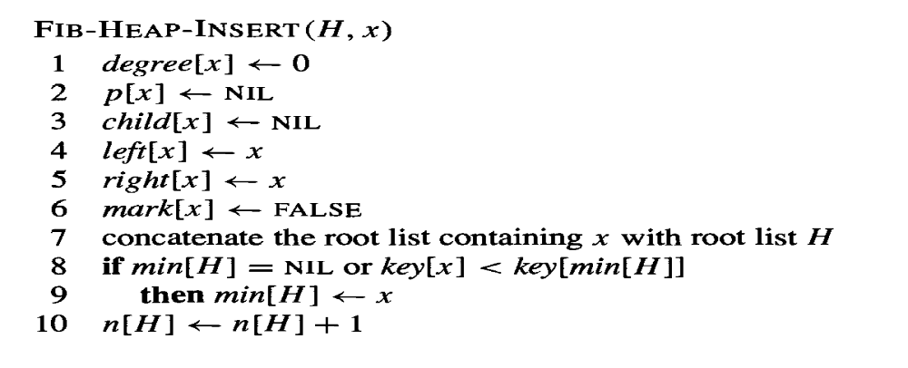
Inserting a node
The following procedure inserts node x into Fibonacci heap H , assuming that the node has already been allocated and that key[x] has already been filled in.

Slide 5
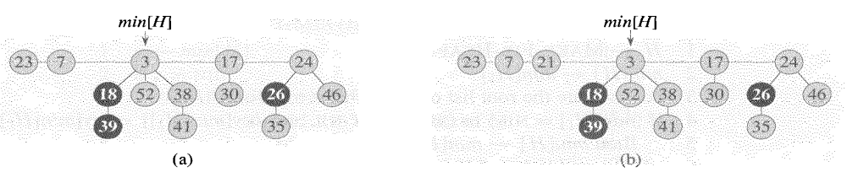
Inserting a node
(a) A Fibonacci heap H
(b) Fibonacci heap H after the node with key 21 has been inserted
FIB-HEAP-INSERT makes no attempt to consolidate the trees within the Fibonacci heap.
If k consecutive FIB-HEAP-INSERT operations occur, then k single-node trees are added to the root list.

Slide 6
Inserting a node
Amortized cost of FIB-HEAP-INSERT
let H be the input Fibonacci heap and H′ be the resulting Fibonacci heap. Then, t(H′) = t(H)+1 and m(H′) = m(H), and the increase in potential is
((t(H) + 1) + 2 m(H)) - (t(H) + 2 m(H)) = 1
Actual cost is O(1)
Amortized cost is O(1)+1=O(1)

Slide 7
Finding the minimum node
The minimum node of a Fibonacci heap H is given by the pointer min[H ], so we can find the minimum node in O(1) actual time.
Because the potential of H does not change, the amortized cost of this operation is equal to its O(1) actual cost.

Slide 8
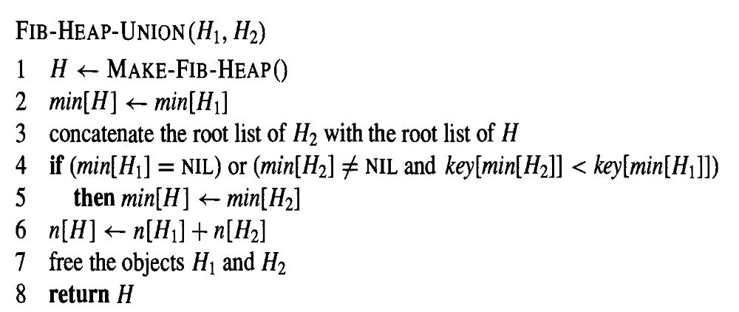
Uniting two Fibonacci heaps
The following procedure unites Fibonacci heaps H1 and H2, destroying H1 and H2 in the process.
It simply concatenates the root lists of H1 and H2 and then determines the new minimum node.

Slide 9
Uniting two Fibonacci heaps
The change in potential is
Φ(H) - (Φ(H1) + Φ(H2))
= (t(H) + 2m(H)) - ((t(H1) + 2 m(H1)) + (t(H2) + 2 m(H2)))= 0
→ t(H) = t(H1) + t(H2) and m(H) = m(H1) + m(H2).

